Slide 1

Sizes of infinity
Paul Dubois

Slide 2
Comparing Sets
Notes:
Def sets; éléments
want compare (size) sets

Slide 3
Comparing Sets
1
2
1
2
3
4
3
4
5
6
5
6
7
7
Notes:
1st method: counting

Slide 4
Comparing Sets
=
Notes:
Def sets; éléments
want compare (size) sets

Slide 5
Comparing Sets
=
Notes:
Def sets; éléments
want compare (size) sets

Slide 6
Comparing Sets
Notes:
Def sets; éléments
want compare (size) sets

Slide 7
Comparing Sets
<
Notes:
Def sets; éléments
want compare (size) sets

Slide 8
Comparing Sets
11
10
9
8
7
6
5
4
3
2
1
0
Notes:
Def sets; éléments
want compare (size) sets

Slide 9
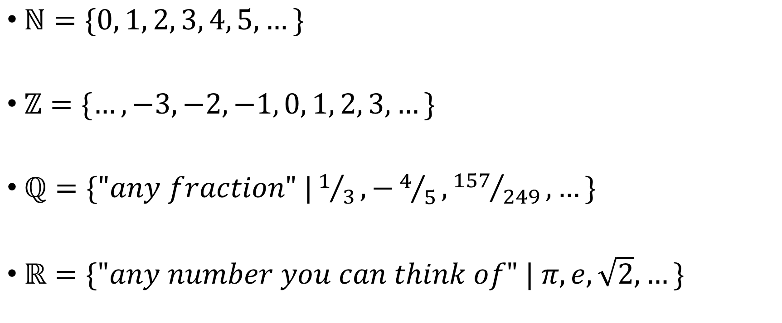

Notation
$ℕ=\{0, 1, 2, 3, 4, 5, …\}$
$ℤ=\{…, −3, −2, −1, 0, 1, 2, 3, …\}$
$ℚ=\{"any fraction" |1/3,−4/5,{157}/{249}, …\}$
$ℝ=\{"any number you can think of" | π, e, \sqrt{2}, …\}$
$A=\{a, b, c, …,z\}$

Slide 10
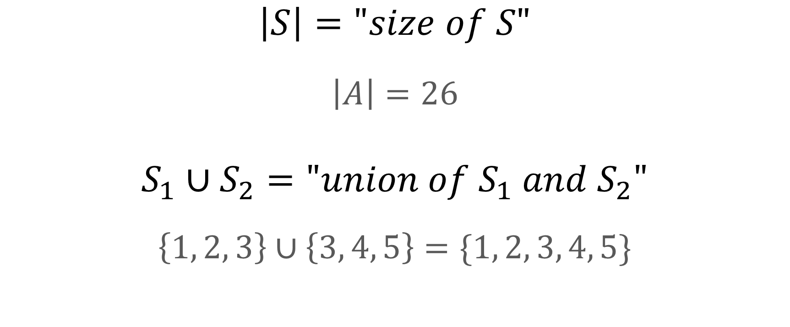
Notation
$$\left|S\right|="size of S"$$
$$\left|A\right|=26$$
$$S_{1}∪S_{2}="union of S_{1} and S_{2}"$$
$$\left\{1, 2, 3\right\}∪\left\{3, 4, 5\right\}=\{1, 2, 3, 4, 5\}$$

Slide 11




$$\left|ℕ∪\{∗\}\right|=\left|ℕ\right|$$
?
$$ℕ$$
0
1
2
3
4
5
6
7
8
9
10
11
$$ℕ∪\{∗\}$$
$$∗$$
0
1
2
3
4
5
6
7
8
9
10
11

Slide 12
$$\left|ℕ∪\{∗\}\right|=\left|ℕ\right|$$
?
$$ℕ$$
0
1
2
3
4
5
6
7
8
9
10
11
>
$$ℕ∪\{∗\}$$
$$∗$$
0
1
2
3
4
5
6
7
8
9
10
11

Slide 13

$$\left|ℕ∪\{∗\}\right|=\left|ℕ\right|$$
?
$$ℕ$$
0
1
2
3
4
5
6
7
8
9
10
11
=
>
$$ℕ∪\{∗\}$$
$$∗$$
0
1
2
3
4
5
6
7
8
9
10
11

Slide 14



$$\left|ℕ∪A\right|=\left|ℕ\right|$$
?
$$ℕ$$
0
1
2
3
…
24
25
26
27
28
29
30
=
$$ℕ∪A$$
$$a$$
b
c
d
…
y
z
0
1
2
3
4

Slide 15


$$\left|ℤ\right|=\left|ℕ\right|$$
?
$$ℕ$$
0
1
2
3
4
5
6
7
8
>
$$ℤ$$
-8
-7
-6
-5
-4
-3
-2
-1
0
1
2
3
4
5
6
7
8

Slide 16
$$\left|ℤ\right|=\left|ℕ\right|$$
?
$$ℕ$$
0
1
2
3
4
5
6
7
8
9
10
=
$$ℤ$$
0
1
2
3
4
5
-1
-2
-3
-4
-5

Slide 17


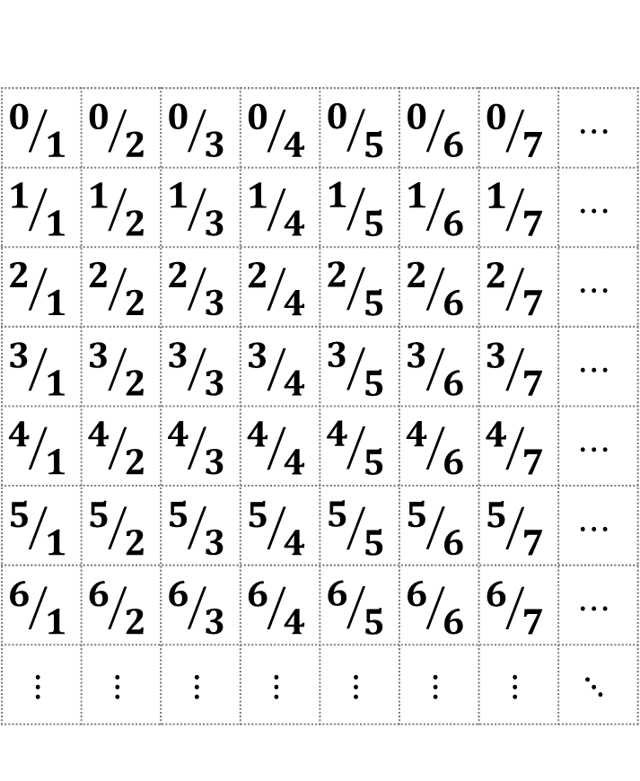
$$\left|ℕ\right|=\left|ℚ\right|$$
?
0
1
2
3
4
5
6
7
8
9
10
$$⋮$$
$$0/1$$ | $$0/2$$ | $$0/3$$ | $$0/4$$ | $$0/5$$ | $$0/6$$ | $$0/7$$ | $$⋯$$
$$1/1$$ | $$1/2$$ | $$1/3$$ | $$1/4$$ | $$1/5$$ | $$1/6$$ | $$1/7$$ | $$⋯$$
$$2/1$$ | $$2/2$$ | $$2/3$$ | $$2/4$$ | $$2/5$$ | $$2/6$$ | $$2/7$$ | $$⋯$$
$$3/1$$ | $$3/2$$ | $$3/3$$ | $$3/4$$ | $$3/5$$ | $$3/6$$ | $$3/7$$ | $$⋯$$
$$4/1$$ | $$4/2$$ | $$4/3$$ | $$4/4$$ | $$4/5$$ | $$4/6$$ | $$4/7$$ | $$⋯$$
$$5/1$$ | $$5/2$$ | $$5/3$$ | $$5/4$$ | $$5/5$$ | $$5/6$$ | $$5/7$$ | $$⋯$$
$$6/1$$ | $$6/2$$ | $$6/3$$ | $$6/4$$ | $$6/5$$ | $$6/6$$ | $$6/7$$ | $$⋯$$
$$⋮$$ | $$⋮$$ | $$⋮$$ | $$⋮$$ | $$⋮$$ | $$⋮$$ | $$⋮$$ | $$⋱$$

Slide 18

$$\left|ℕ\right|=\left|ℚ\right|$$
?
0
1
2
3
4
5
6
7
8
9
10
$$⋮$$
$$0/1$$
$$1/1$$
$$2/1$$
$$3/1$$
$$4/1$$
$$5/1$$
$$6/1$$
$$⋮$$

Slide 19

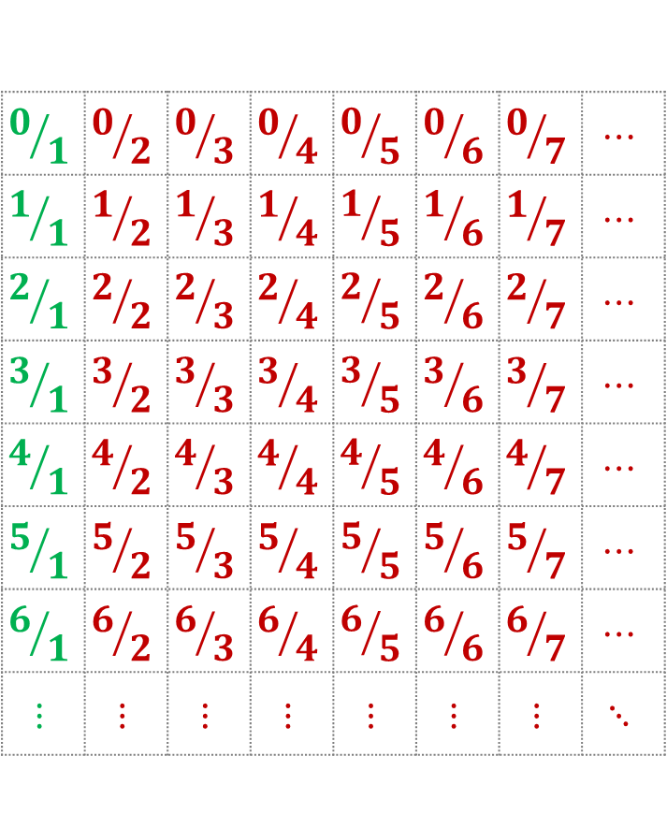
$$\left|ℕ\right|=\left|ℚ\right|$$
0
1
2
3
4
5
6
7
8
9
10
$$⋮$$
$$0/1$$ | $$0/2$$ | $$0/3$$ | $$0/4$$ | $$0/5$$ | $$0/6$$ | $$0/7$$ | $$⋯$$
$$1/1$$ | $$1/2$$ | $$1/3$$ | $$1/4$$ | $$1/5$$ | $$1/6$$ | $$1/7$$ | $$⋯$$
$$2/1$$ | $$2/2$$ | $$2/3$$ | $$2/4$$ | $$2/5$$ | $$2/6$$ | $$2/7$$ | $$⋯$$
$$3/1$$ | $$3/2$$ | $$3/3$$ | $$3/4$$ | $$3/5$$ | $$3/6$$ | $$3/7$$ | $$⋯$$
$$4/1$$ | $$4/2$$ | $$4/3$$ | $$4/4$$ | $$4/5$$ | $$4/6$$ | $$4/7$$ | $$⋯$$
$$5/1$$ | $$5/2$$ | $$5/3$$ | $$5/4$$ | $$5/5$$ | $$5/6$$ | $$5/7$$ | $$⋯$$
$$6/1$$ | $$6/2$$ | $$6/3$$ | $$6/4$$ | $$6/5$$ | $$6/6$$ | $$6/7$$ | $$⋯$$
$$⋮$$ | $$⋮$$ | $$⋮$$ | $$⋮$$ | $$⋮$$ | $$⋮$$ | $$⋮$$ | $$⋱$$

Slide 20
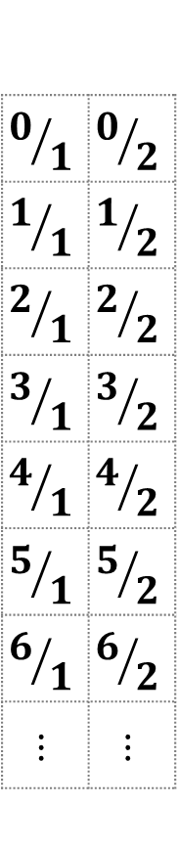
$$\left|ℕ\right|=\left|ℚ\right|$$
?
0
1
2
3
4
5
6
7
8
9
10
$$⋮$$
$$0/1$$ | $$0/2$$
$$1/1$$ | $$1/2$$
$$2/1$$ | $$2/2$$
$$3/1$$ | $$3/2$$
$$4/1$$ | $$4/2$$
$$5/1$$ | $$5/2$$
$$6/1$$ | $$6/2$$
$$⋮$$ | $$⋮$$

Slide 21
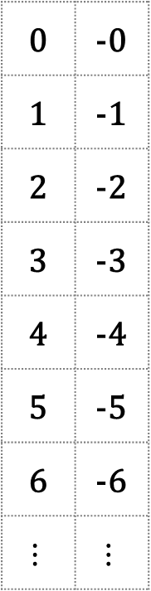
$$\left|ℕ\right|=\left|ℚ\right|$$
?
0
1
2
3
4
5
6
7
8
9
10
$$⋮$$
0 | -0
1 | -1
2 | -2
3 | -3
4 | -4
5 | -5
6 | -6
$$⋮$$ | $$⋮$$

Slide 22
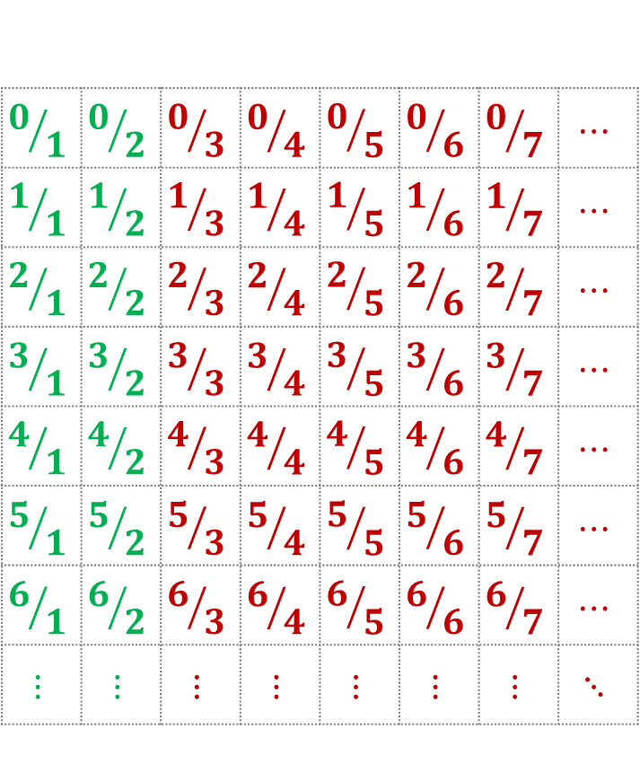
$$\left|ℕ\right|=\left|ℚ\right|$$
?
0
1
2
3
4
5
6
7
8
9
10
$$⋮$$
$$0/1$$ | $$0/2$$ | $$0/3$$ | $$0/4$$ | $$0/5$$ | $$0/6$$ | $$0/7$$ | $$⋯$$
$$1/1$$ | $$1/2$$ | $$1/3$$ | $$1/4$$ | $$1/5$$ | $$1/6$$ | $$1/7$$ | $$⋯$$
$$2/1$$ | $$2/2$$ | $$2/3$$ | $$2/4$$ | $$2/5$$ | $$2/6$$ | $$2/7$$ | $$⋯$$
$$3/1$$ | $$3/2$$ | $$3/3$$ | $$3/4$$ | $$3/5$$ | $$3/6$$ | $$3/7$$ | $$⋯$$
$$4/1$$ | $$4/2$$ | $$4/3$$ | $$4/4$$ | $$4/5$$ | $$4/6$$ | $$4/7$$ | $$⋯$$
$$5/1$$ | $$5/2$$ | $$5/3$$ | $$5/4$$ | $$5/5$$ | $$5/6$$ | $$5/7$$ | $$⋯$$
$$6/1$$ | $$6/2$$ | $$6/3$$ | $$6/4$$ | $$6/5$$ | $$6/6$$ | $$6/7$$ | $$⋯$$
$$⋮$$ | $$⋮$$ | $$⋮$$ | $$⋮$$ | $$⋮$$ | $$⋮$$ | $$⋮$$ | $$⋱$$

Slide 23
$$\left|ℕ\right|=\left|ℚ\right|$$
?
0
1
2
3
4
5
6
7
8
9
10
$$⋮$$
$$0/1$$ | $$0/2$$ | $$0/3$$ | $$0/4$$ | $$0/5$$ | $$0/6$$ | $$0/7$$ | $$⋯$$
$$1/1$$ | $$1/2$$ | $$1/3$$ | $$1/4$$ | $$1/5$$ | $$1/6$$ | $$1/7$$ | $$⋯$$
$$2/1$$ | $$2/2$$ | $$2/3$$ | $$2/4$$ | $$2/5$$ | $$2/6$$ | $$2/7$$ | $$⋯$$
$$3/1$$ | $$3/2$$ | $$3/3$$ | $$3/4$$ | $$3/5$$ | $$3/6$$ | $$3/7$$ | $$⋯$$
$$4/1$$ | $$4/2$$ | $$4/3$$ | $$4/4$$ | $$4/5$$ | $$4/6$$ | $$4/7$$ | $$⋯$$
$$5/1$$ | $$5/2$$ | $$5/3$$ | $$5/4$$ | $$5/5$$ | $$5/6$$ | $$5/7$$ | $$⋯$$
$$6/1$$ | $$6/2$$ | $$6/3$$ | $$6/4$$ | $$6/5$$ | $$6/6$$ | $$6/7$$ | $$⋯$$
$$⋮$$ | $$⋮$$ | $$⋮$$ | $$⋮$$ | $$⋮$$ | $$⋮$$ | $$⋮$$ | $$⋱$$

Slide 24
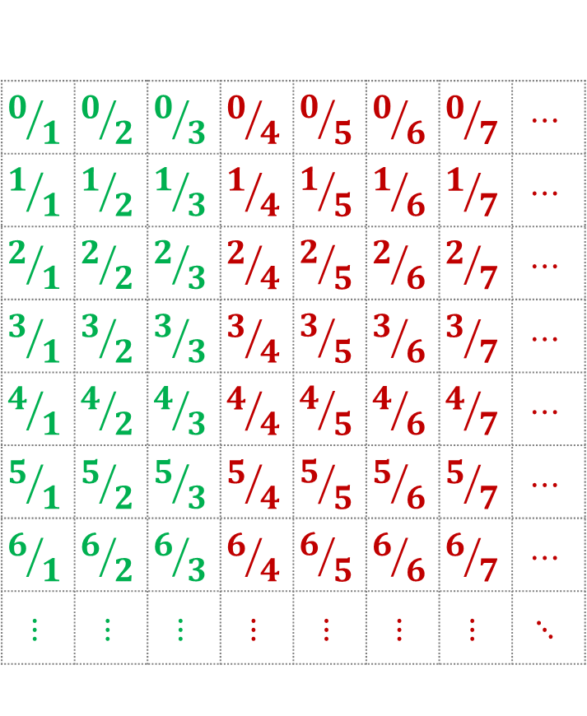
$$\left|ℕ\right|=\left|ℚ\right|$$
?
0
1
2
3
4
5
6
7
8
9
10
$$⋮$$
$$0/1$$ | $$0/2$$ | $$0/3$$ | $$0/4$$ | $$0/5$$ | $$0/6$$ | $$0/7$$ | $$⋯$$
$$1/1$$ | $$1/2$$ | $$1/3$$ | $$1/4$$ | $$1/5$$ | $$1/6$$ | $$1/7$$ | $$⋯$$
$$2/1$$ | $$2/2$$ | $$2/3$$ | $$2/4$$ | $$2/5$$ | $$2/6$$ | $$2/7$$ | $$⋯$$
$$3/1$$ | $$3/2$$ | $$3/3$$ | $$3/4$$ | $$3/5$$ | $$3/6$$ | $$3/7$$ | $$⋯$$
$$4/1$$ | $$4/2$$ | $$4/3$$ | $$4/4$$ | $$4/5$$ | $$4/6$$ | $$4/7$$ | $$⋯$$
$$5/1$$ | $$5/2$$ | $$5/3$$ | $$5/4$$ | $$5/5$$ | $$5/6$$ | $$5/7$$ | $$⋯$$
$$6/1$$ | $$6/2$$ | $$6/3$$ | $$6/4$$ | $$6/5$$ | $$6/6$$ | $$6/7$$ | $$⋯$$
$$⋮$$ | $$⋮$$ | $$⋮$$ | $$⋮$$ | $$⋮$$ | $$⋮$$ | $$⋮$$ | $$⋱$$

Slide 25
$$\left|ℕ\right|=\left|ℚ\right|$$
?
0
1
2
3
4
5
6
7
8
9
10
$$⋮$$
$$0/1$$ | $$0/2$$ | $$0/3$$ | $$0/4$$ | $$0/5$$ | $$0/6$$ | $$0/7$$ | $$⋯$$
$$1/1$$ | $$1/2$$ | $$1/3$$ | $$1/4$$ | $$1/5$$ | $$1/6$$ | $$1/7$$ | $$⋯$$
$$2/1$$ | $$2/2$$ | $$2/3$$ | $$2/4$$ | $$2/5$$ | $$2/6$$ | $$2/7$$ | $$⋯$$
$$3/1$$ | $$3/2$$ | $$3/3$$ | $$3/4$$ | $$3/5$$ | $$3/6$$ | $$3/7$$ | $$⋯$$
$$4/1$$ | $$4/2$$ | $$4/3$$ | $$4/4$$ | $$4/5$$ | $$4/6$$ | $$4/7$$ | $$⋯$$
$$5/1$$ | $$5/2$$ | $$5/3$$ | $$5/4$$ | $$5/5$$ | $$5/6$$ | $$5/7$$ | $$⋯$$
$$6/1$$ | $$6/2$$ | $$6/3$$ | $$6/4$$ | $$6/5$$ | $$6/6$$ | $$6/7$$ | $$⋯$$
$$⋮$$ | $$⋮$$ | $$⋮$$ | $$⋮$$ | $$⋮$$ | $$⋮$$ | $$⋮$$ | $$⋱$$

Slide 26
$$\left|ℕ\right|=\left|ℚ\right|$$
?
0
1
2
3
4
5
6
7
8
9
10
$$⋮$$
$$0/1$$ | $$0/2$$ | $$0/3$$ | $$0/4$$ | $$0/5$$ | $$0/6$$ | $$0/7$$ | $$⋯$$
$$1/1$$ | $$1/2$$ | $$1/3$$ | $$1/4$$ | $$1/5$$ | $$1/6$$ | $$1/7$$ | $$⋯$$
$$2/1$$ | $$2/2$$ | $$2/3$$ | $$2/4$$ | $$2/5$$ | $$2/6$$ | $$2/7$$ | $$⋯$$
$$3/1$$ | $$3/2$$ | $$3/3$$ | $$3/4$$ | $$3/5$$ | $$3/6$$ | $$3/7$$ | $$⋯$$
$$4/1$$ | $$4/2$$ | $$4/3$$ | $$4/4$$ | $$4/5$$ | $$4/6$$ | $$4/7$$ | $$⋯$$
$$5/1$$ | $$5/2$$ | $$5/3$$ | $$5/4$$ | $$5/5$$ | $$5/6$$ | $$5/7$$ | $$⋯$$
$$6/1$$ | $$6/2$$ | $$6/3$$ | $$6/4$$ | $$6/5$$ | $$6/6$$ | $$6/7$$ | $$⋯$$
$$⋮$$ | $$⋮$$ | $$⋮$$ | $$⋮$$ | $$⋮$$ | $$⋮$$ | $$⋮$$ | $$⋱$$

Slide 27
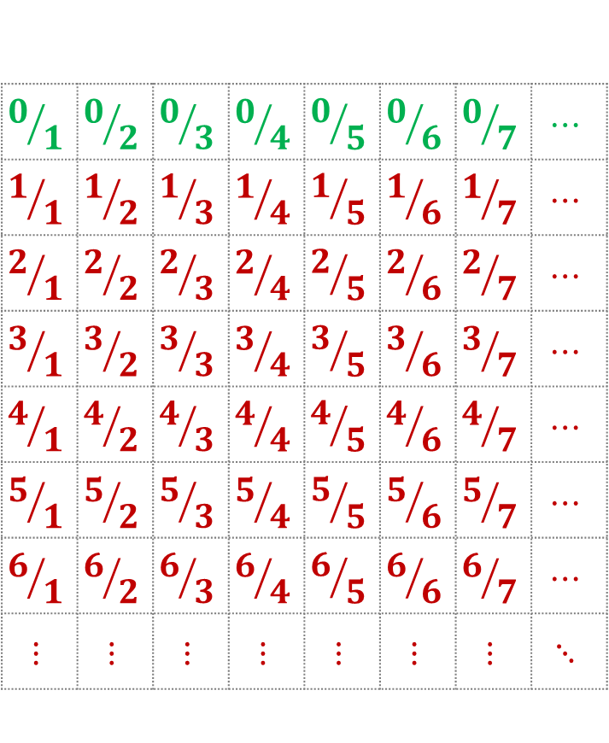
$$\left|ℕ\right|=\left|ℚ\right|$$
?
0
1
2
3
4
5
6
7
8
9
10
$$⋮$$
$$0/1$$ | $$0/2$$ | $$0/3$$ | $$0/4$$ | $$0/5$$ | $$0/6$$ | $$0/7$$ | $$⋯$$
$$1/1$$ | $$1/2$$ | $$1/3$$ | $$1/4$$ | $$1/5$$ | $$1/6$$ | $$1/7$$ | $$⋯$$
$$2/1$$ | $$2/2$$ | $$2/3$$ | $$2/4$$ | $$2/5$$ | $$2/6$$ | $$2/7$$ | $$⋯$$
$$3/1$$ | $$3/2$$ | $$3/3$$ | $$3/4$$ | $$3/5$$ | $$3/6$$ | $$3/7$$ | $$⋯$$
$$4/1$$ | $$4/2$$ | $$4/3$$ | $$4/4$$ | $$4/5$$ | $$4/6$$ | $$4/7$$ | $$⋯$$
$$5/1$$ | $$5/2$$ | $$5/3$$ | $$5/4$$ | $$5/5$$ | $$5/6$$ | $$5/7$$ | $$⋯$$
$$6/1$$ | $$6/2$$ | $$6/3$$ | $$6/4$$ | $$6/5$$ | $$6/6$$ | $$6/7$$ | $$⋯$$
$$⋮$$ | $$⋮$$ | $$⋮$$ | $$⋮$$ | $$⋮$$ | $$⋮$$ | $$⋮$$ | $$⋱$$

Slide 28
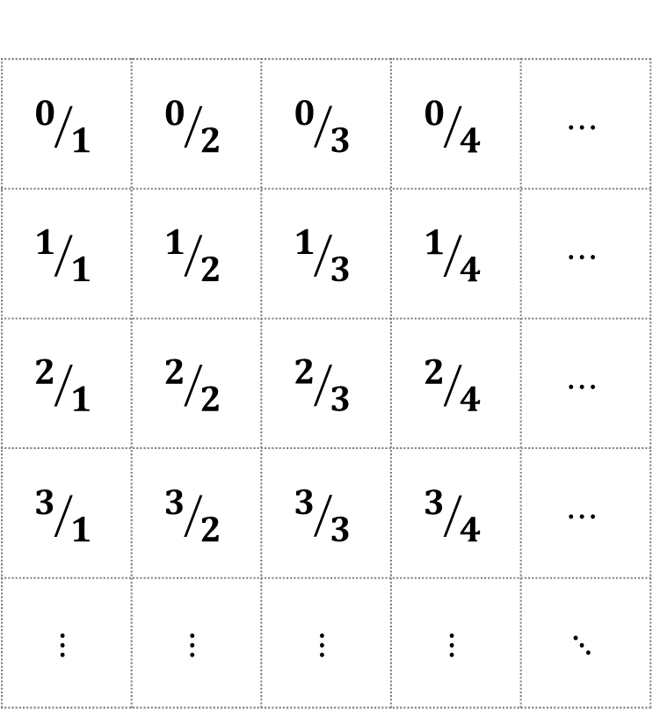
$$\left|ℕ\right|=\left|ℚ\right|$$
?
0
1
2
3
4
5
6
7
8
9
10
$$⋮$$
$$0/1$$ | $$0/2$$ | $$0/3$$ | $$0/4$$ | $$⋯$$
$$1/1$$ | $$1/2$$ | $$1/3$$ | $$1/4$$ | $$⋯$$
$$2/1$$ | $$2/2$$ | $$2/3$$ | $$2/4$$ | $$⋯$$
$$3/1$$ | $$3/2$$ | $$3/3$$ | $$3/4$$ | $$⋯$$
$$⋮$$ | $$⋮$$ | $$⋮$$ | $$⋮$$ | $$⋱$$

Slide 29
$$\left|ℕ\right|=\left|ℚ\right|$$
?
0
1
2
3
4
5
6
7
8
9
10
$$⋮$$
$$0/1$$ | $$0/2$$ | $$0/3$$ | $$0/4$$ | $$⋯$$
$$1/1$$ | $$1/2$$ | $$1/3$$ | $$1/4$$ | $$⋯$$
$$2/1$$ | $$2/2$$ | $$2/3$$ | $$2/4$$ | $$⋯$$
$$3/1$$ | $$3/2$$ | $$3/3$$ | $$3/4$$ | $$⋯$$
$$⋮$$ | $$⋮$$ | $$⋮$$ | $$⋮$$ | $$⋱$$

Slide 30
$$\left|ℕ\right|=\left|ℚ\right|$$
?
0
1
2
3
4
5
6
7
8
9
10
$$⋮$$
$$0/1$$ | $$0/2$$ | $$0/3$$ | $$0/4$$ | $$⋯$$
$$1/1$$ | $$1/2$$ | $$1/3$$ | $$1/4$$ | $$⋯$$
$$2/1$$ | $$2/2$$ | $$2/3$$ | $$2/4$$ | $$⋯$$
$$3/1$$ | $$3/2$$ | $$3/3$$ | $$3/4$$ | $$⋯$$
$$⋮$$ | $$⋮$$ | $$⋮$$ | $$⋮$$ | $$⋱$$
=

Slide 31


$$\left|ℕ\right|=\left|ℤ\right|=\left|ℚ\right|$$
$ℕ⊂ℤ⊂ℚ$
2/3, -7/8, 169/627
-1, -2, -3, …
0, 1, 2, …

Slide 32



$\left|ℕ\right|=\left|ℤ\right|=\left|ℚ\right|$ $<\left|ℝ\right|$
$ℕ⊂ℤ⊂ℚ$ $⊂ℝ$
$$π, e, \sqrt{2},…$$
2/3, -7/8, 169/627
-1, -2, -3, …
0, 1, 2, …

